Slide 1

Modern Control Theory
Lecture No. 7
Introducing the Concept of Observability
Observability Formulation
Controllability & Observability -- an Overview

Slide 2

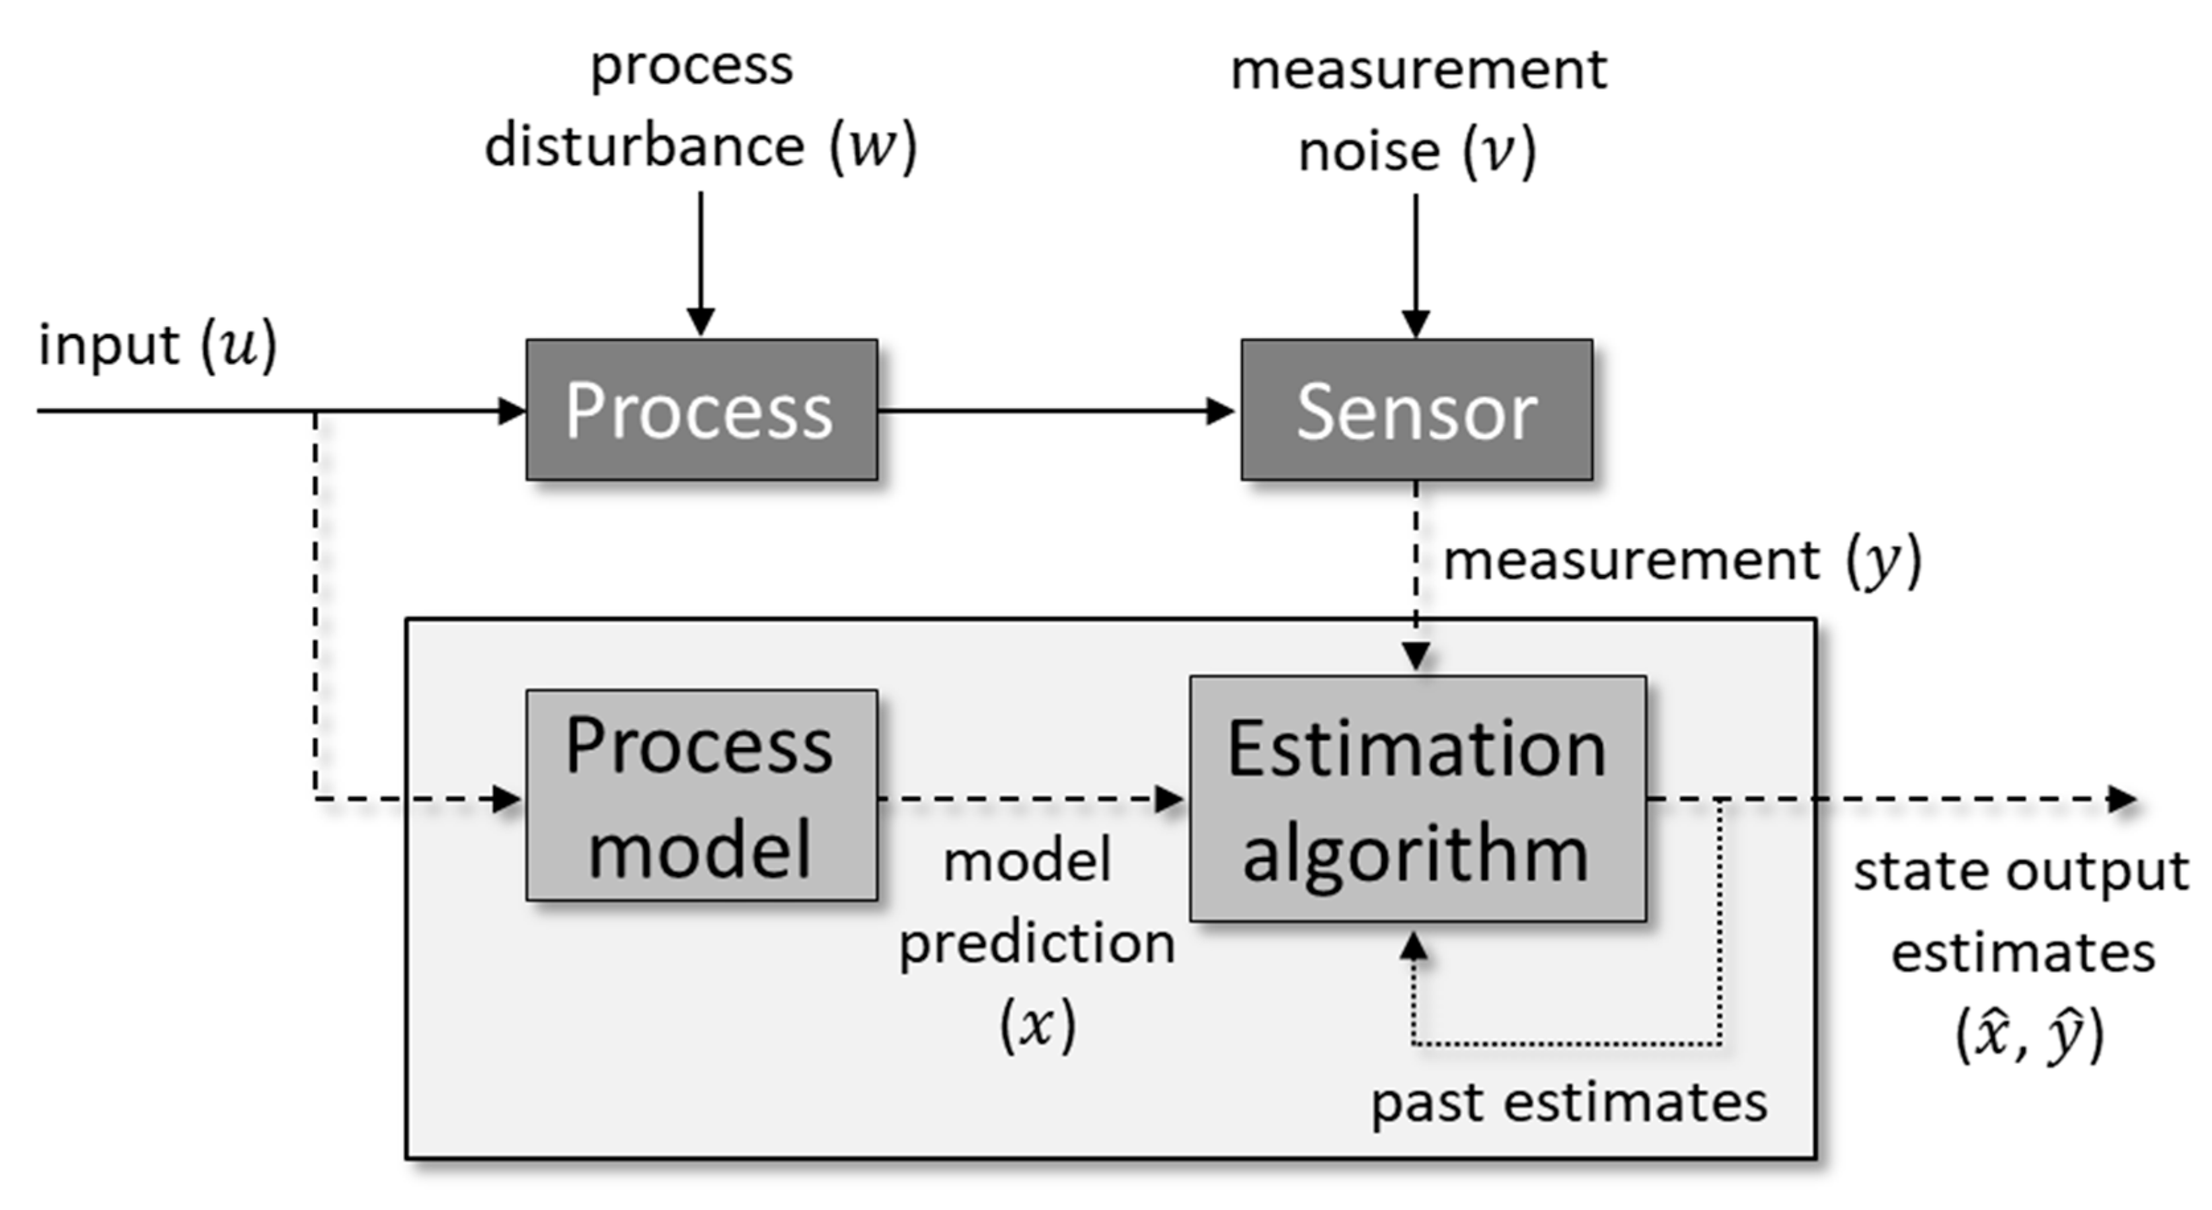
State Space
Observation Space /
Measurement Space
Input Space

Slide 3
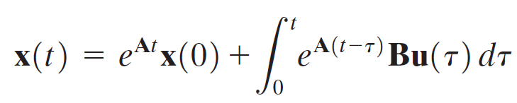
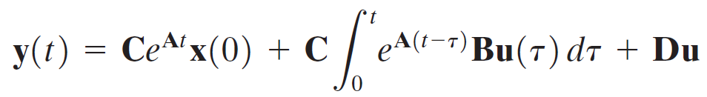
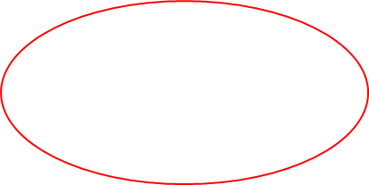
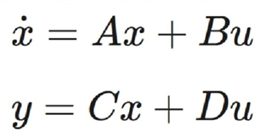
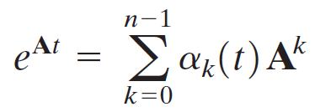

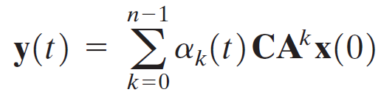
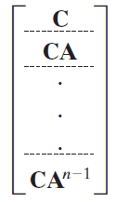
Conceptualizing Observability in Continuous Domain

Slide 4


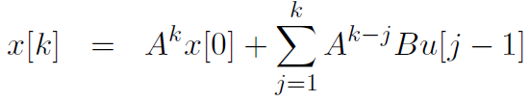
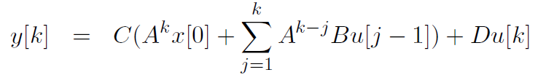
Introduction to Observability
States provide Information about System
Direct Access not there for all States
To obtain States with a Series of Measurements
State Space
Observation Space /
Measurement Space
Input Space
If Model Eqn. is Accurate --- All States determined from X(0)
Unique Identification of Initial State with Given Measurements

Slide 5
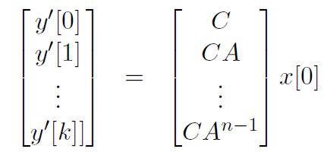

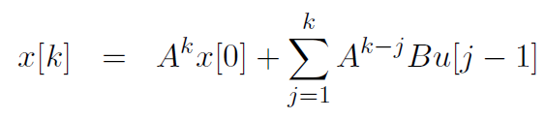
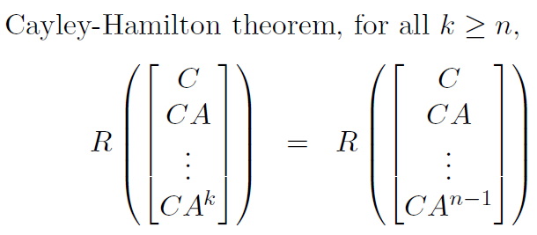
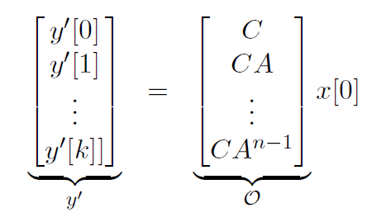
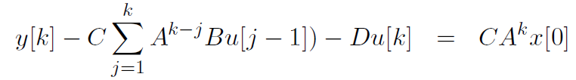

Concept of Observability in Discrete Domain

Slide 6
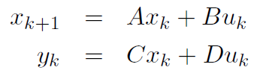


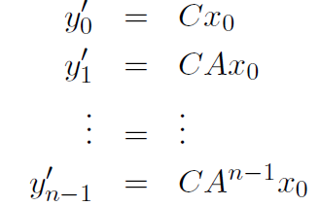

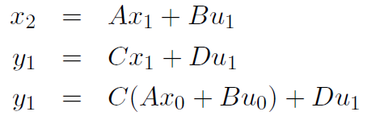
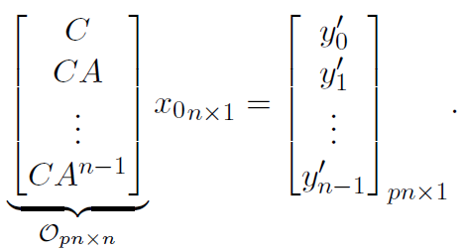


Slide 7

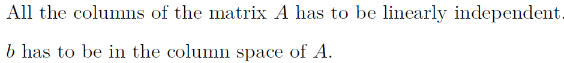
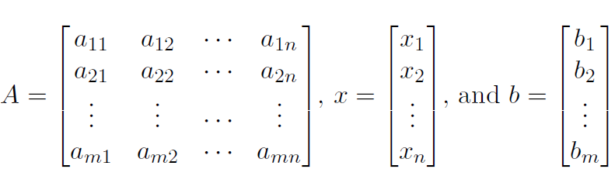


Controllability
Observability
Cols. of A --- Span the Complete Space of R
Matrix A has m l.i. Columns
All Rows of A are l.i. since No. of l.i Cols. = No. of l.i. Rows
Condn. on A to have at least one soln. for every vector b E R, is that A should be of full row rank
Cols.
All Vectors in A should be l.i. Full Rank, Square

